Slide 1
TERRY FINNEGAN PRESENTATIONS

Slide 2
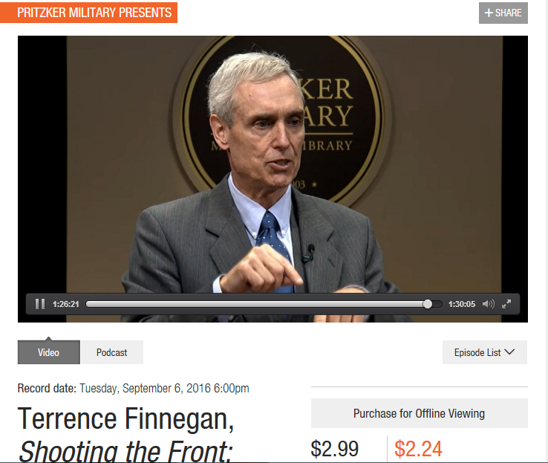
http://www.pritzkermilitary.org/whats_on/pritzker-military-presents/terrence-finnegan-shooting-front/

Slide 3
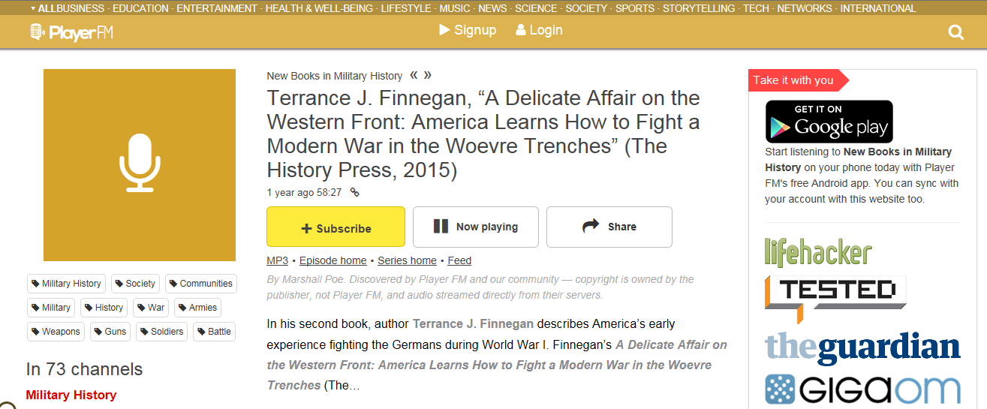
https://player.fm/series/new-books-in-military-history/terrance-j-finnegan-a-delicate-affair-on-the-western-front-america-learns-how-to-fight-a-modern-war-in-the-woevre-trenches-the-history-press-2015

Slide 4
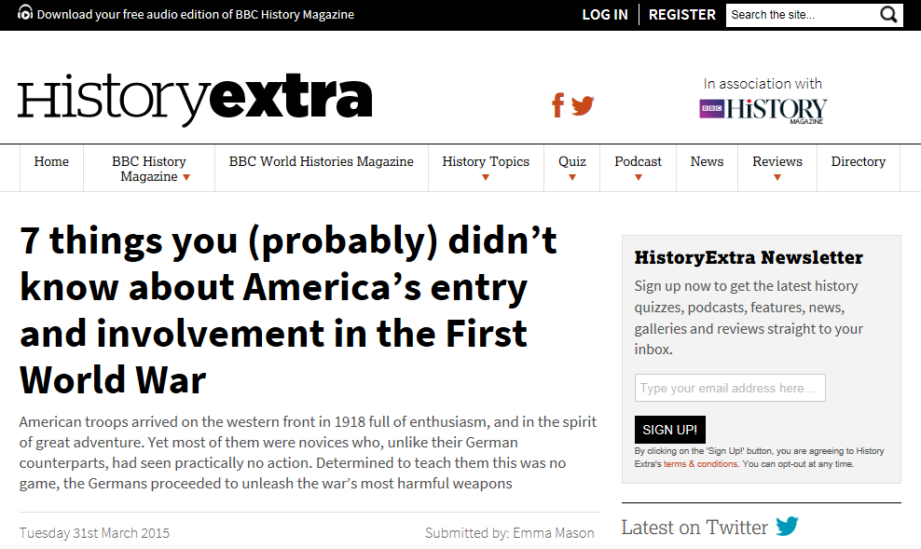
http://www.historyextra.com/article/military-history/7-things-you-probably-didnt-know-about-americas-entry-and-involvement-fir

Slide 5
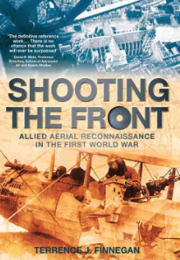
Terry Finnegan Presentations Over the Years
Headquarters SHAPE, Mons, BE
Bristol Historical Society, Bristol, CT
Imperial War Museum, London, UK
Museum of Flight, Seattle, WA
RAF Museum, London, UK
RAF Wyton, UK

Slide 6
Terry Finnegan Presentations 2016
First Division Museum, Cantigny, IL
Bristol Historical Society, Bristol, CT
Pritzker Military Museum, Chicago, IL
USAF Museum, Wright-Patterson AFB, OH

Slide 7
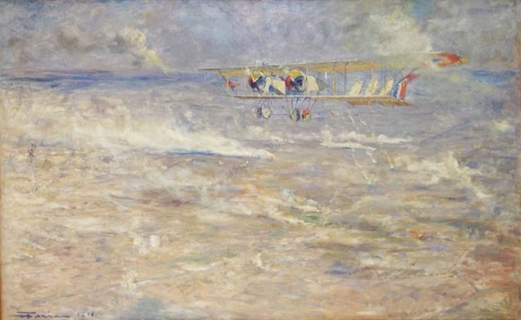
Shooting the Front
The Great War’s Impact on Aviation:
The Third Dimension Ascends

Slide 8
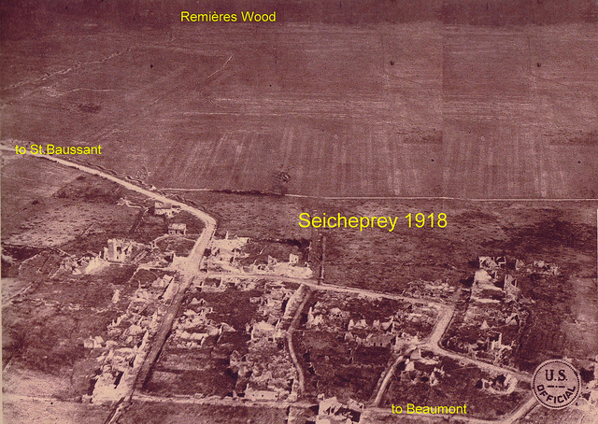
A Delicate Affair on the Western Front

Slide 9
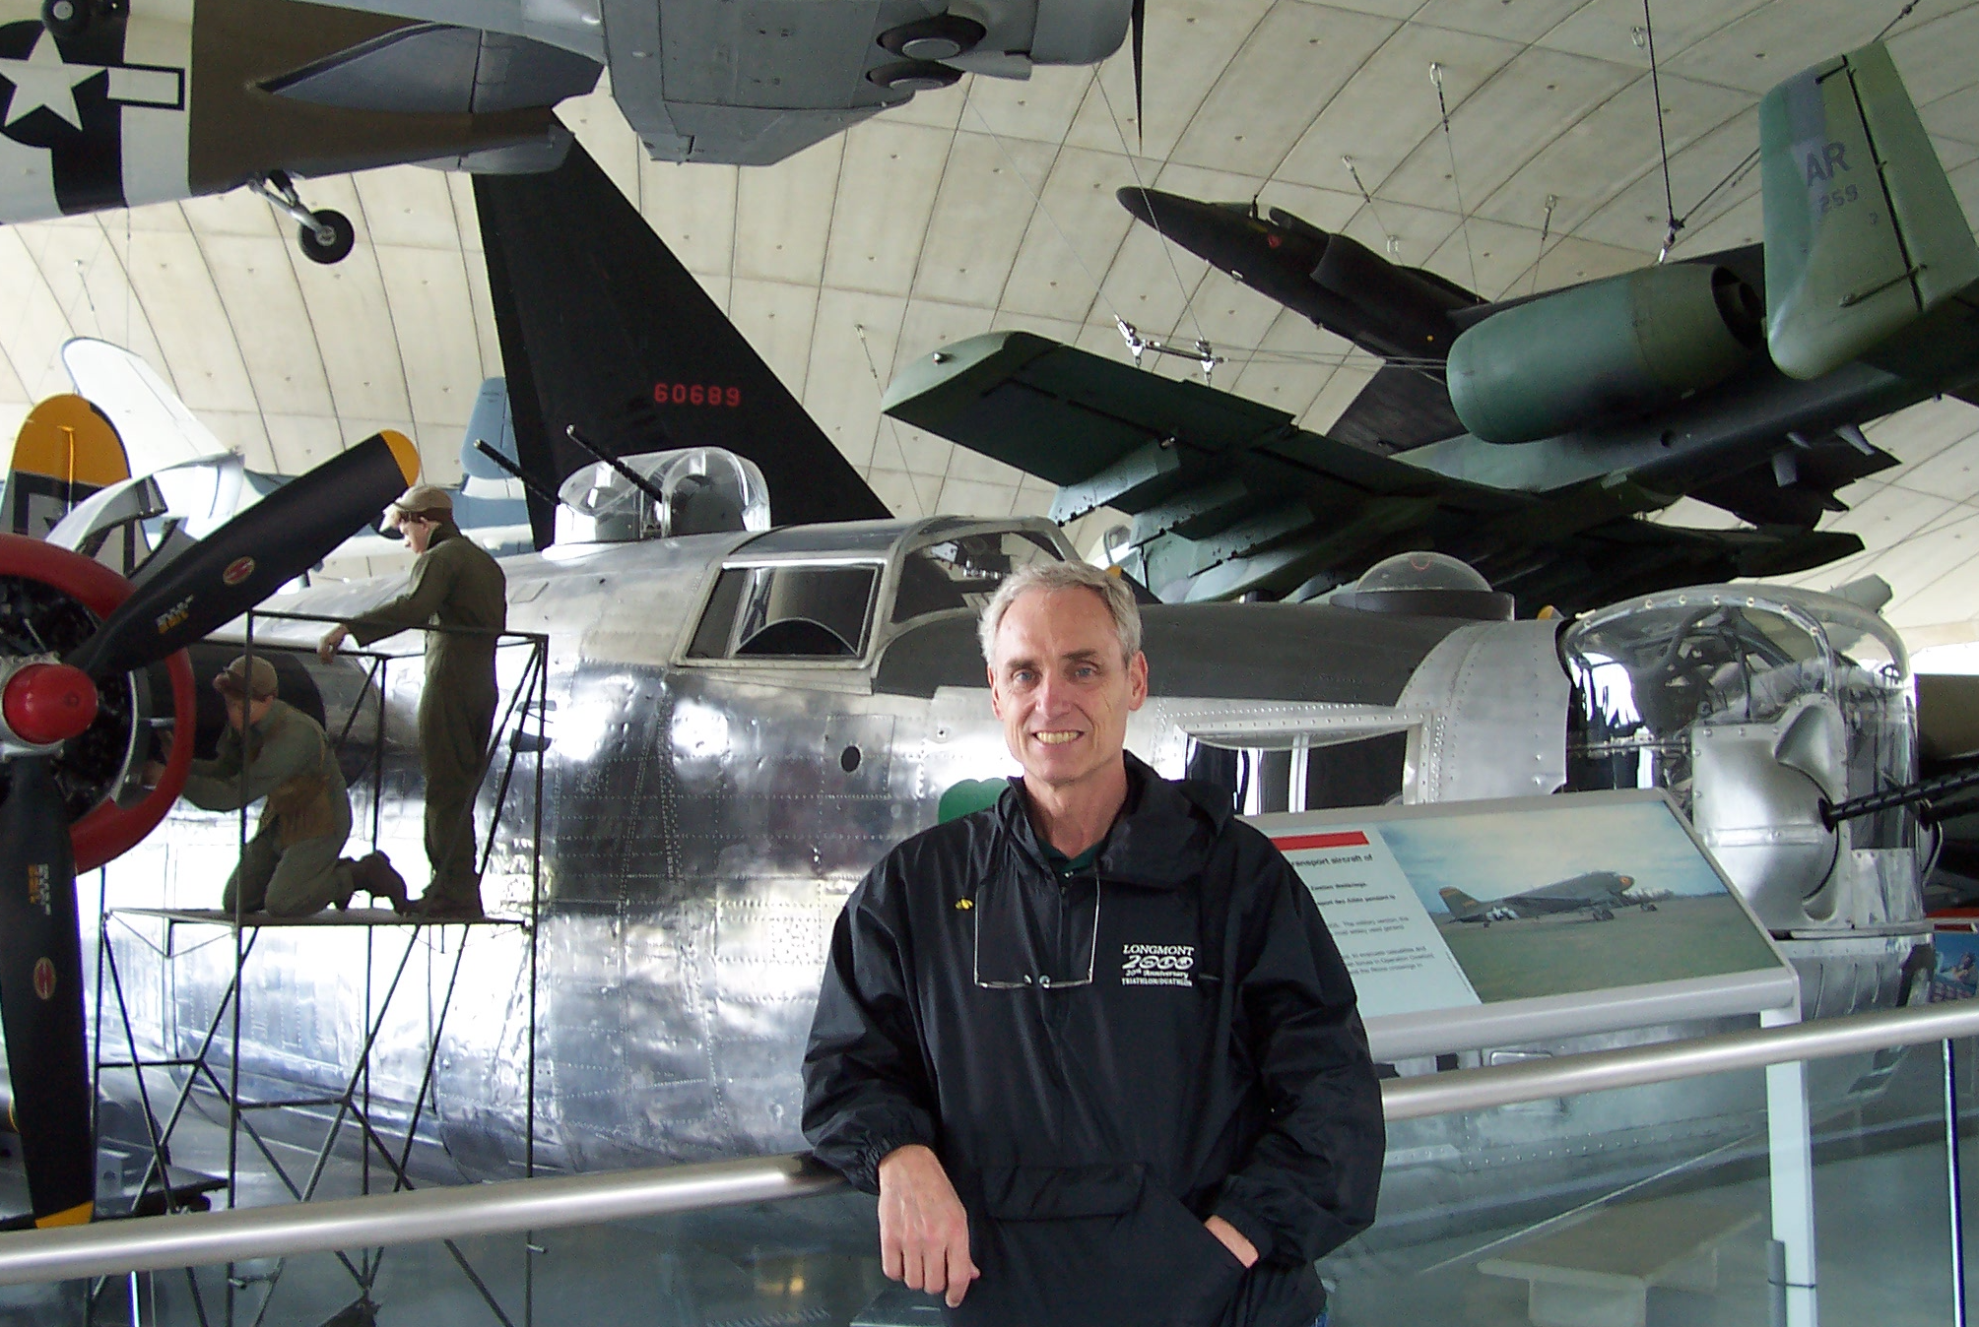
TERRY FINNEGAN
OTHER WW1 PRESENTATIONS

Slide 10
The Yankee Division Validates the U.S. Air Service

Slide 11
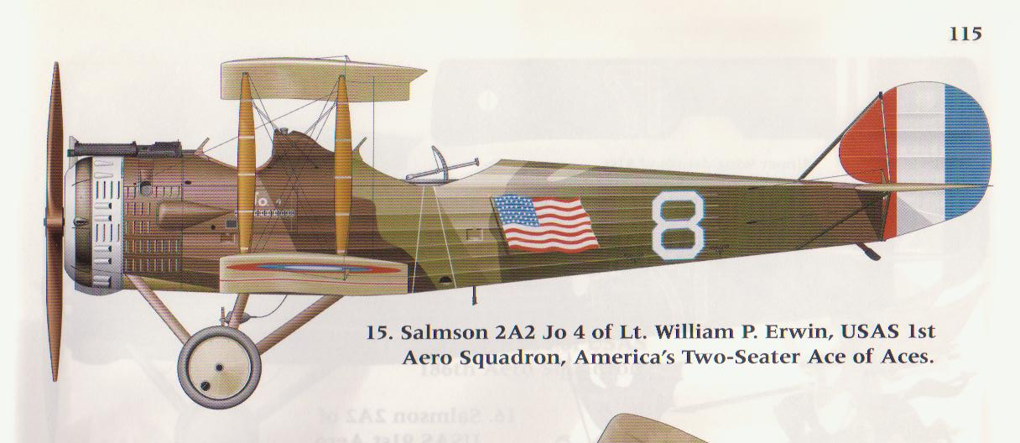
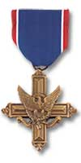
The First Aero Squadron - 1918
Establishing a 100 year legacy for aerial reconnaissance

Slide 12
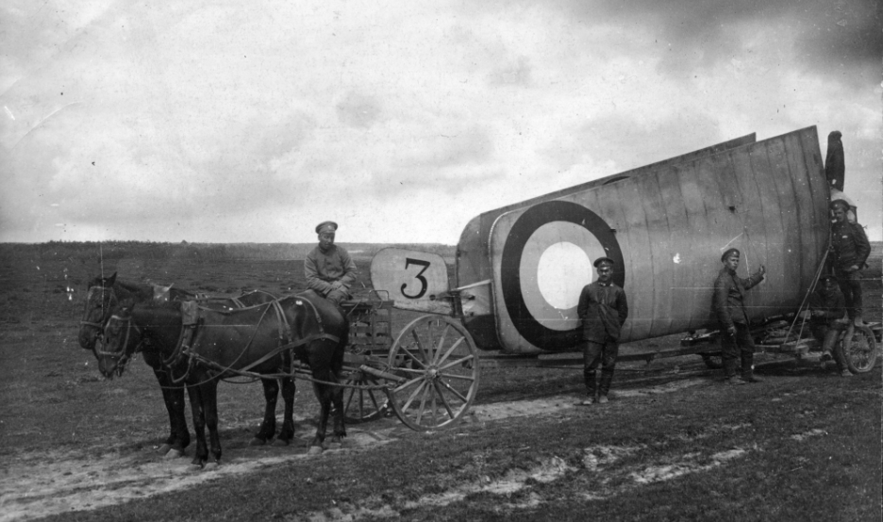
RUSSFRONT!
Aerial Reconnaissance on the Eastern Front in World War I

